Slide 1
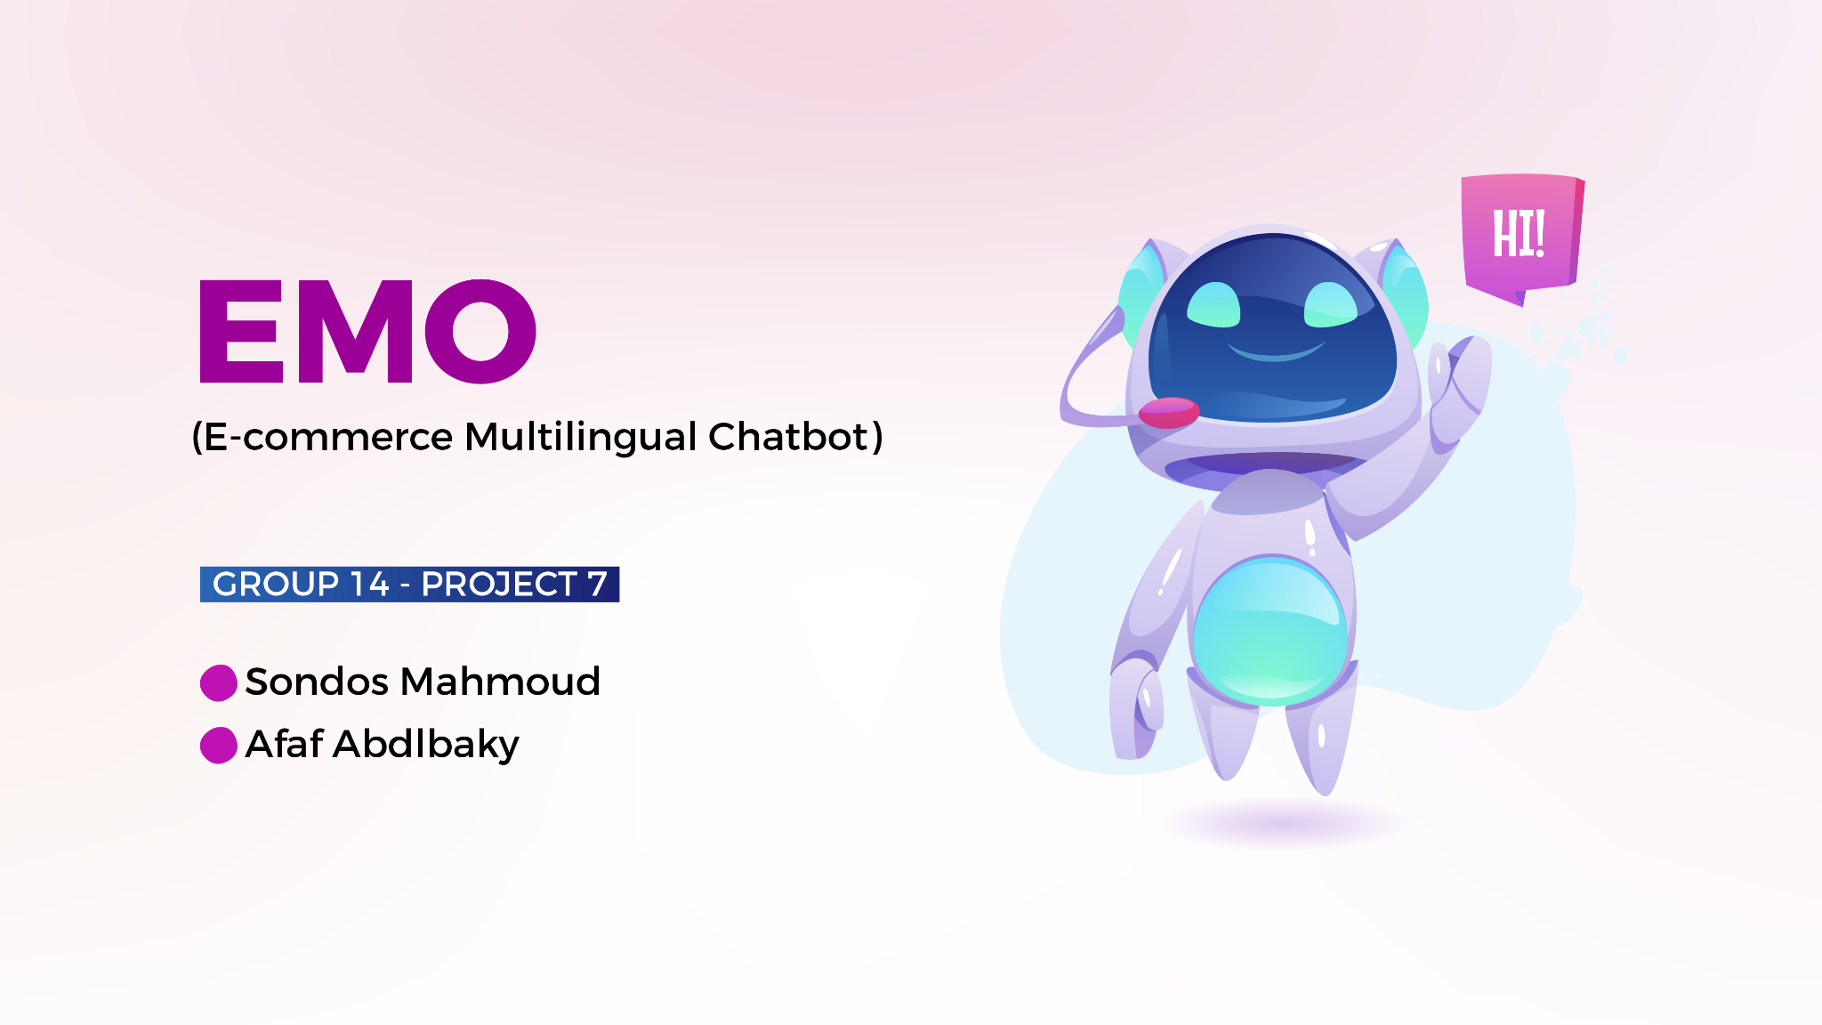

Slide 2
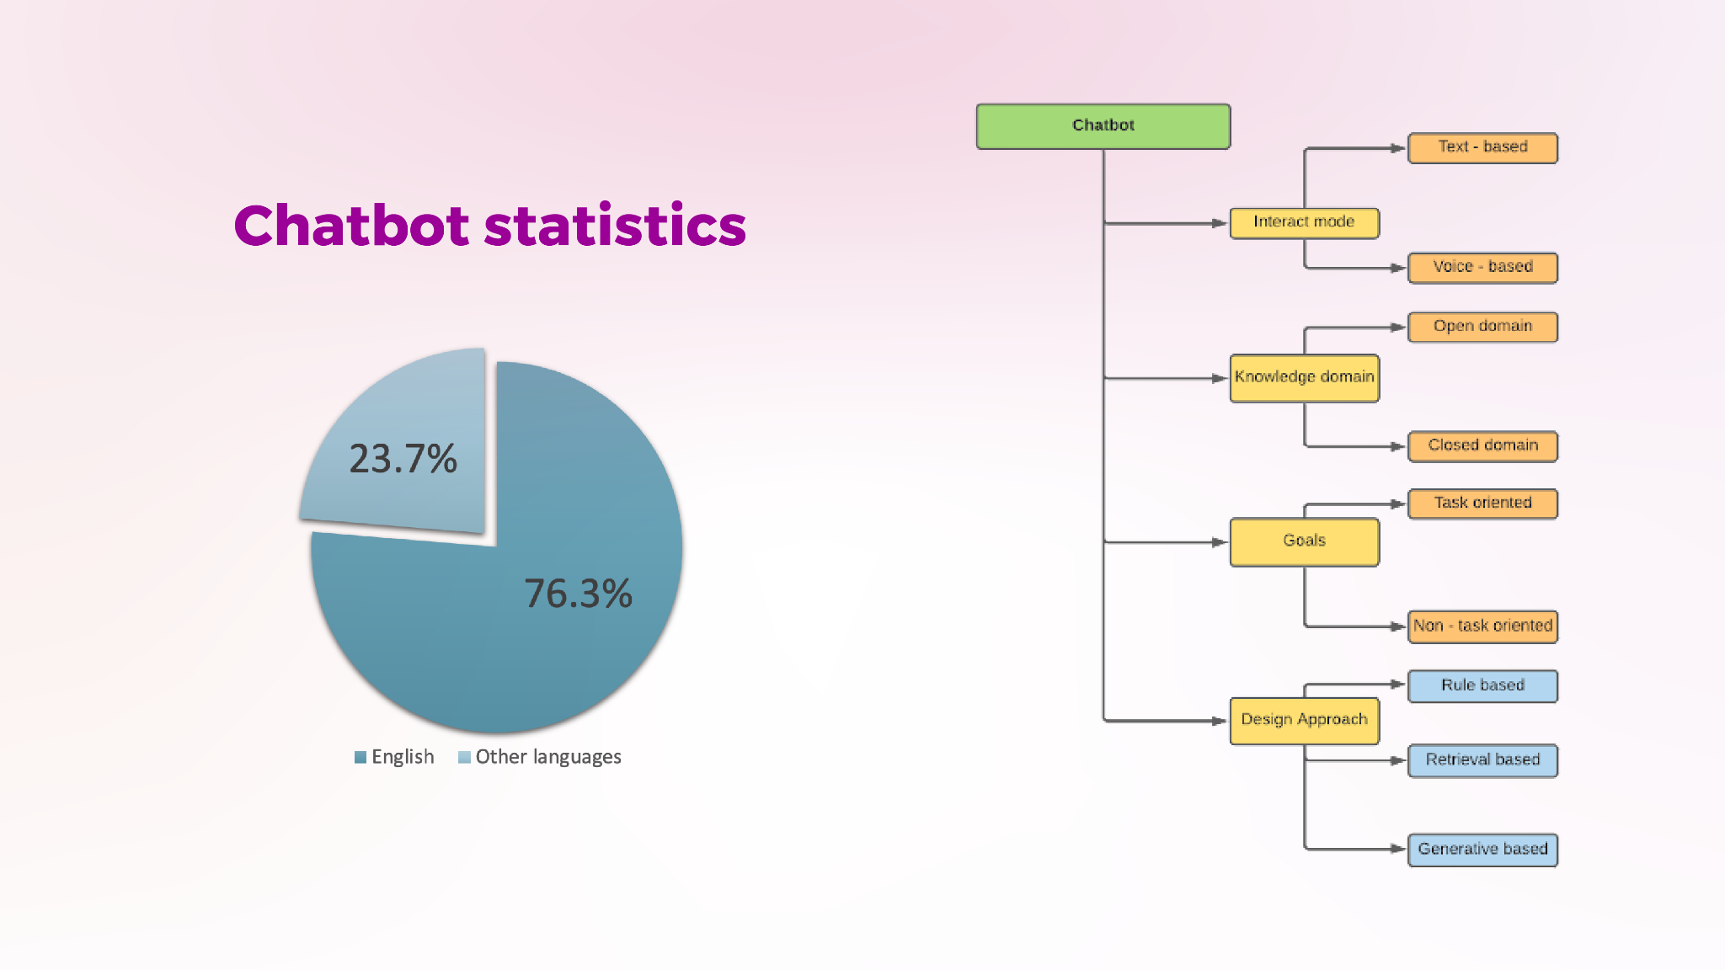
Problem

Slide 3
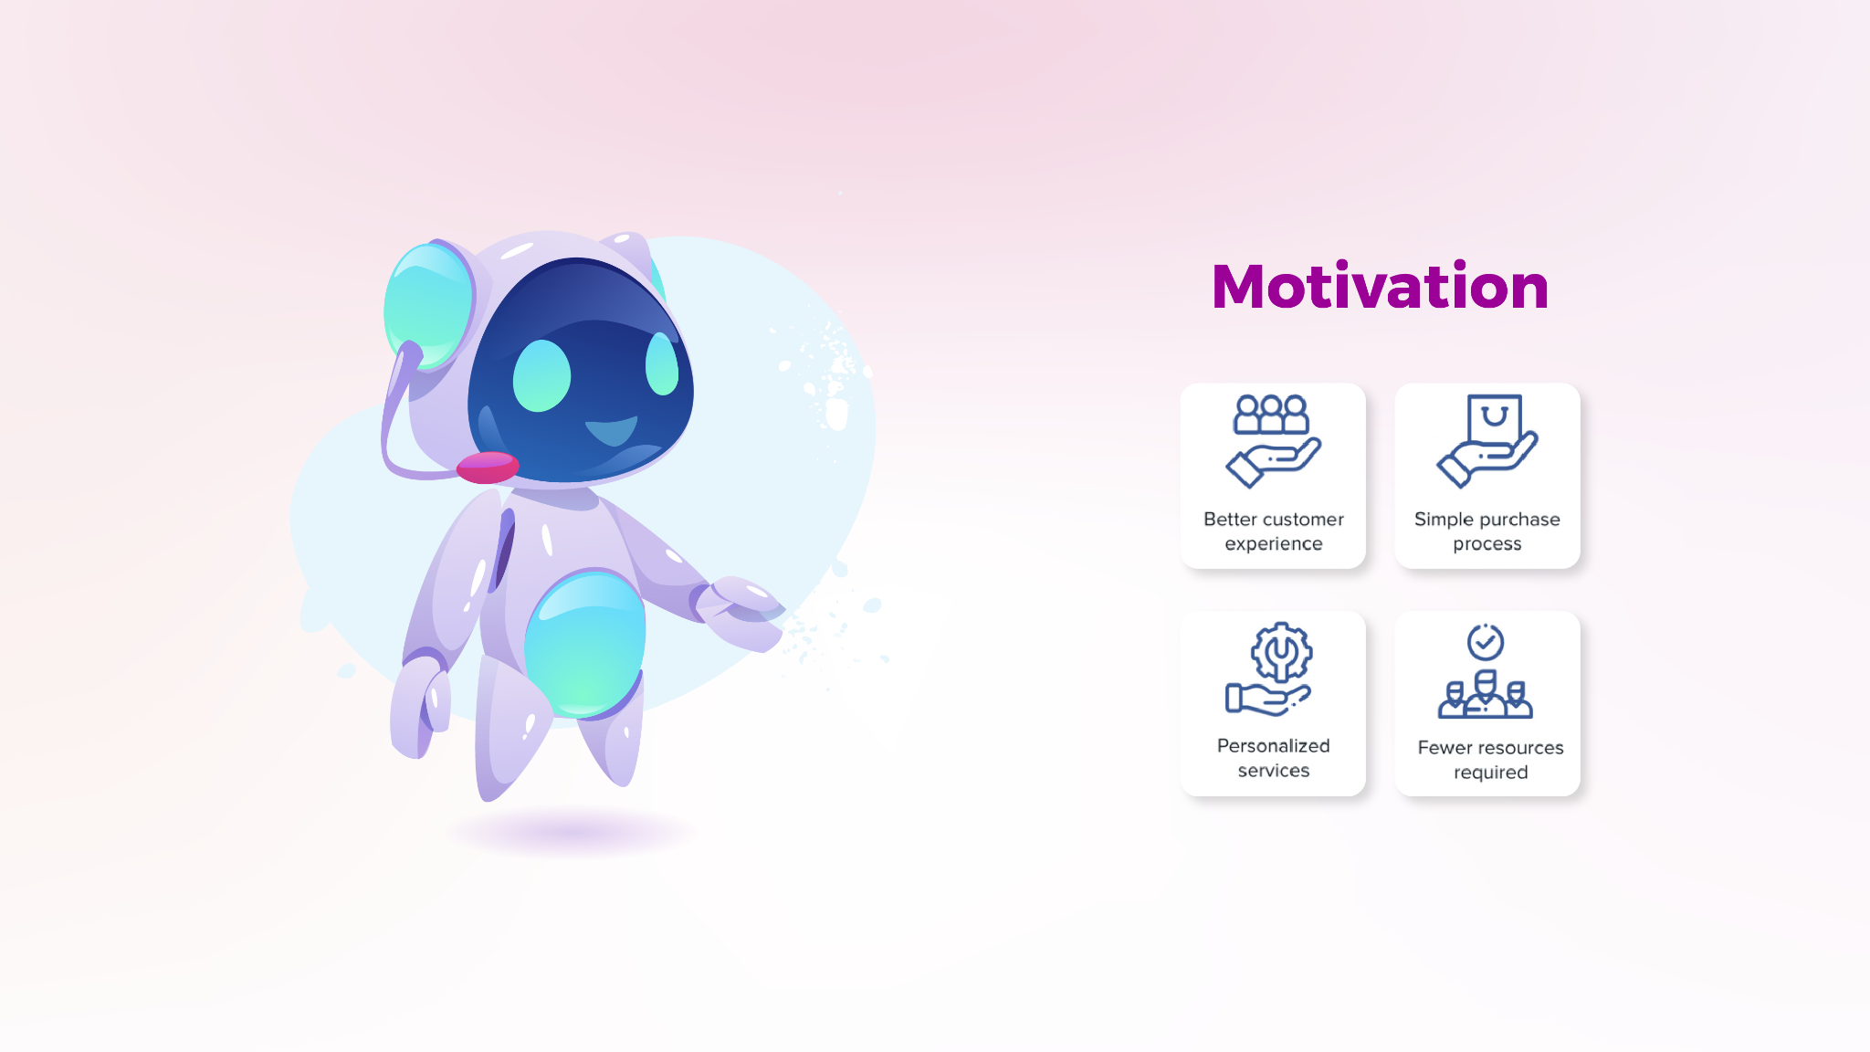

Slide 4
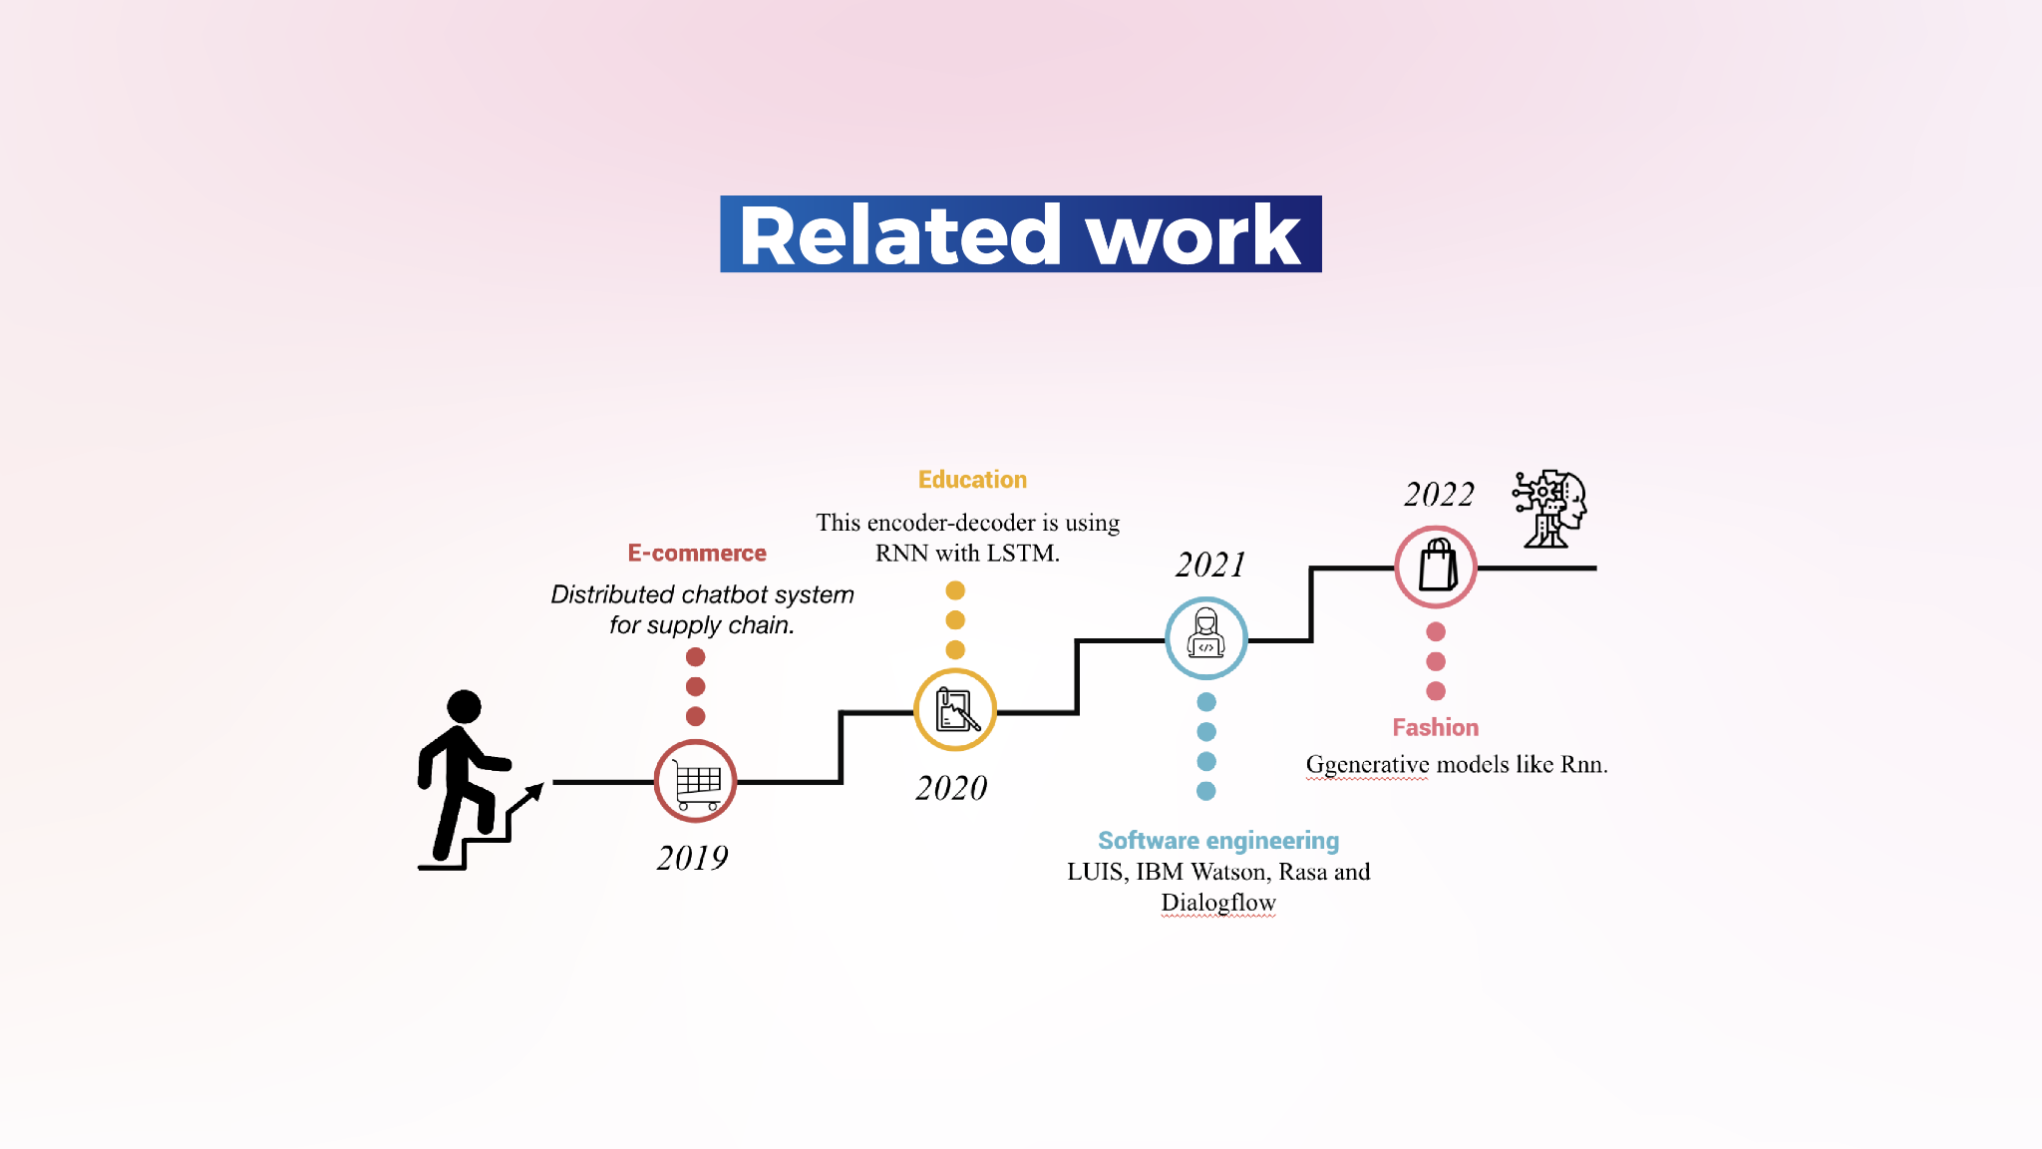

Slide 5
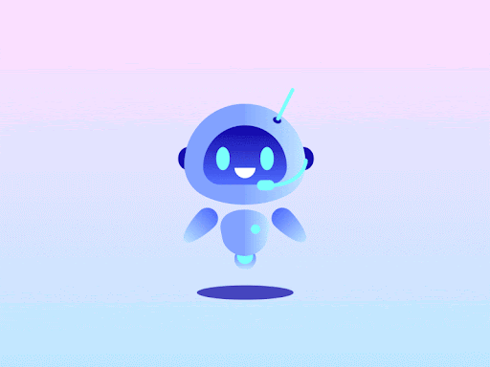

Methodology
Hi, I’m multilingual chatbot. I speak English and Arabic languages

Slide 6
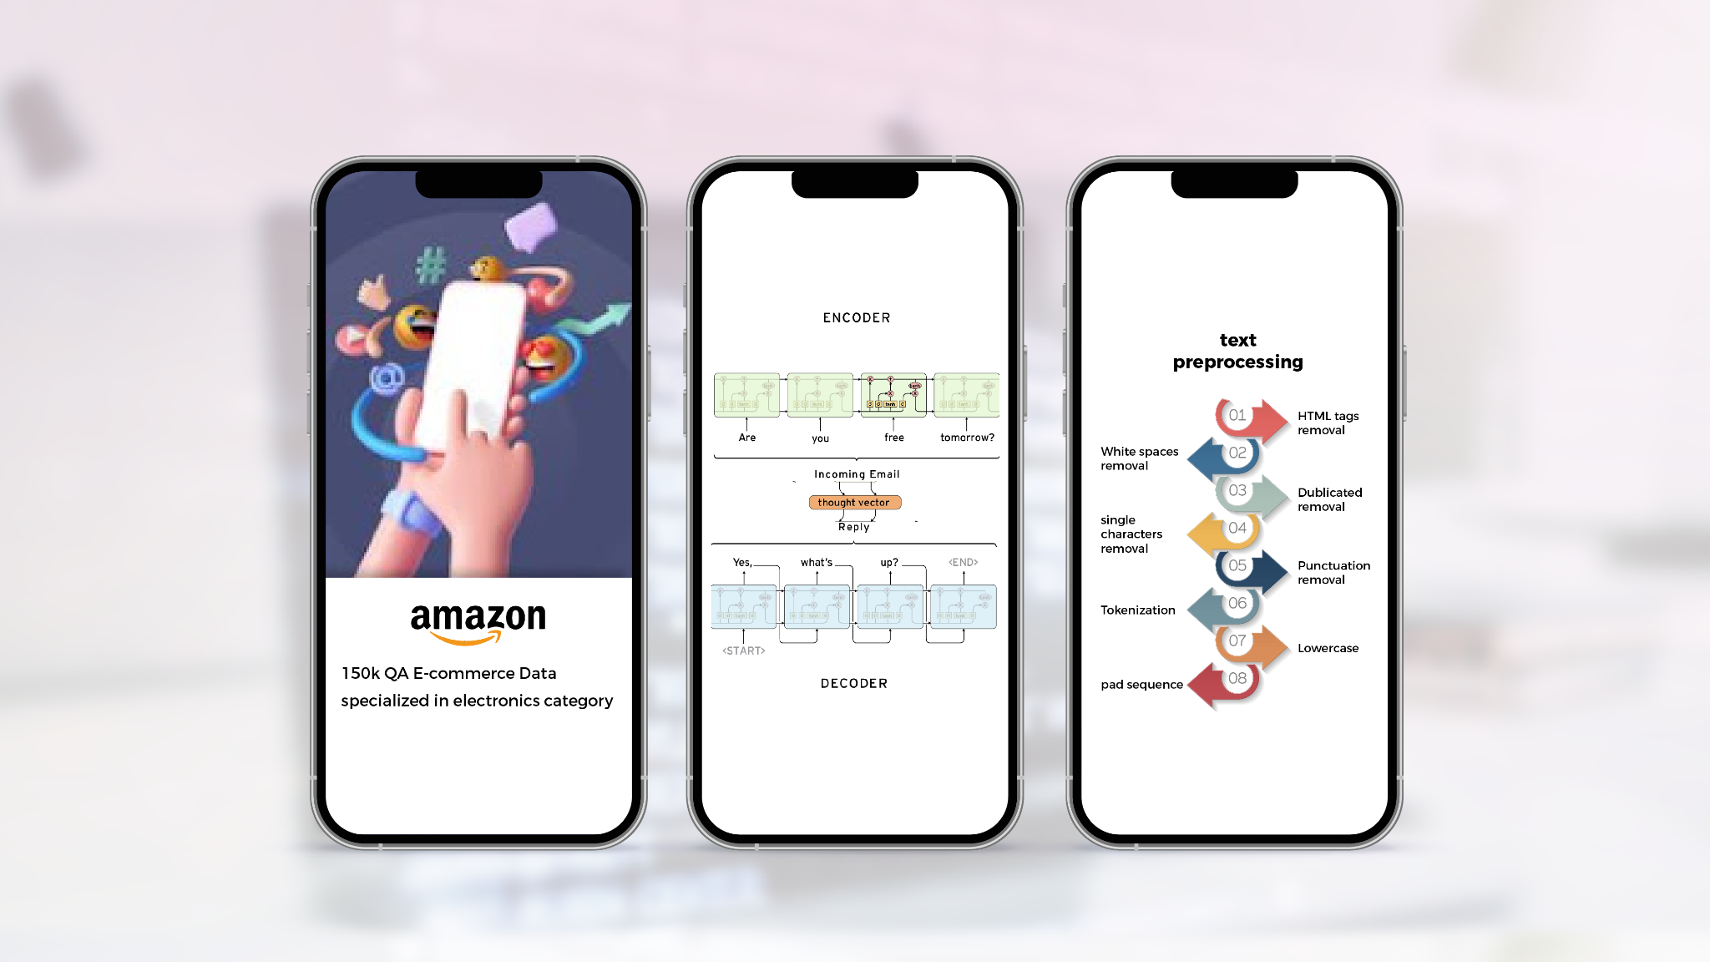


Slide 7
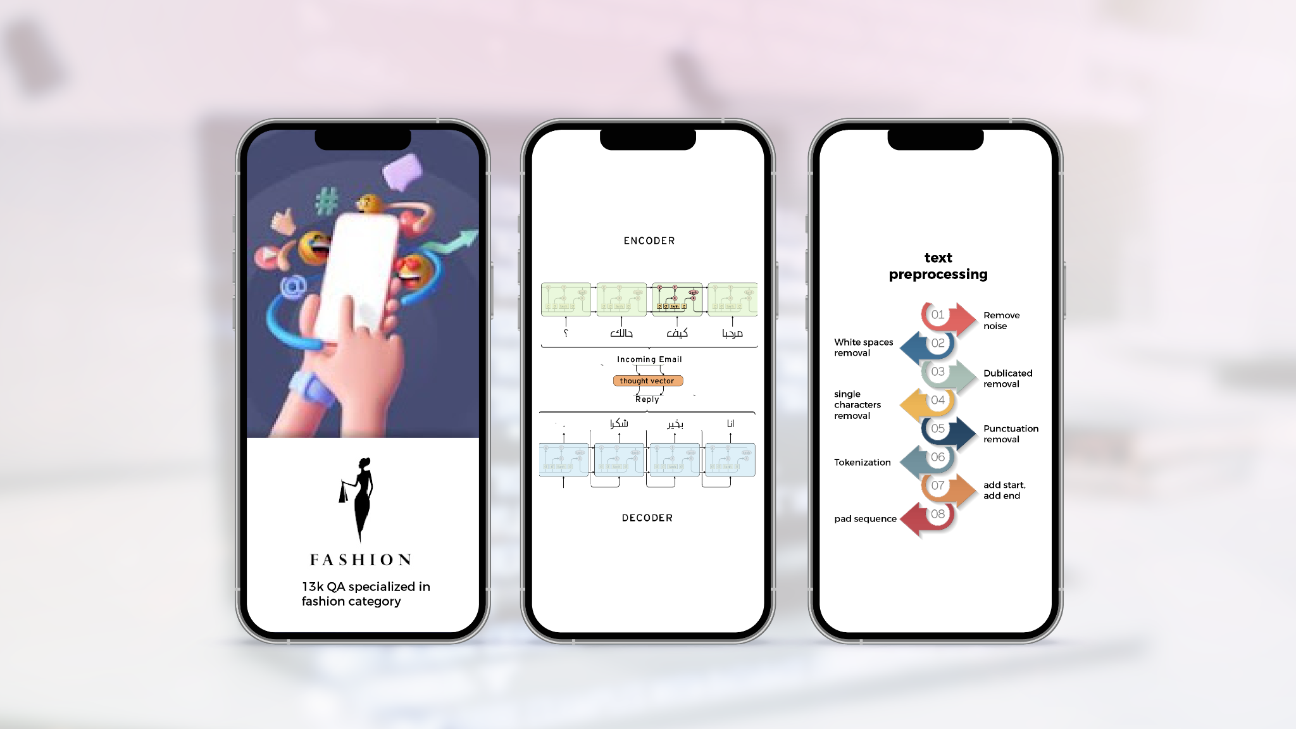


Slide 8
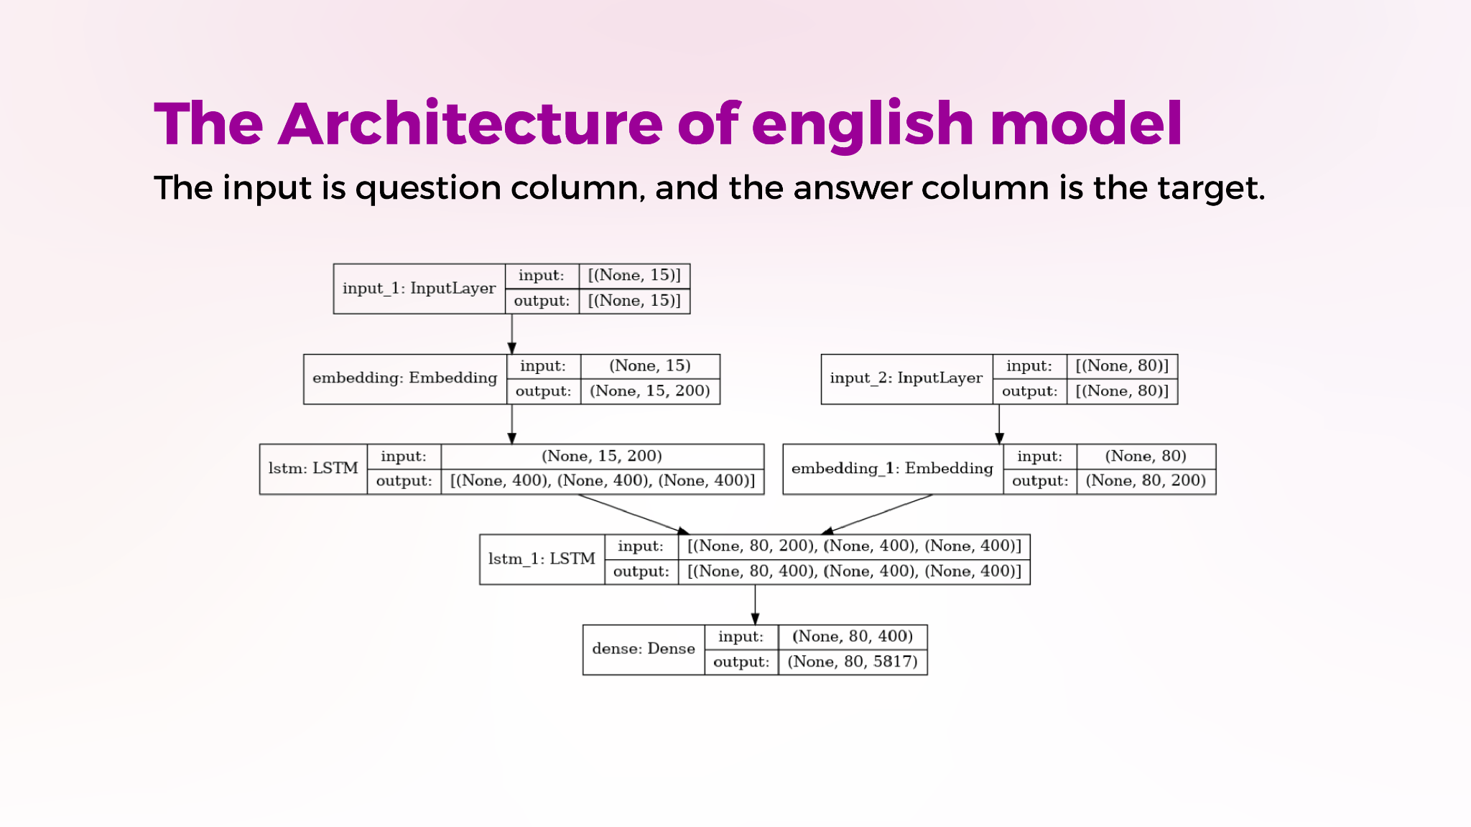

Slide 9
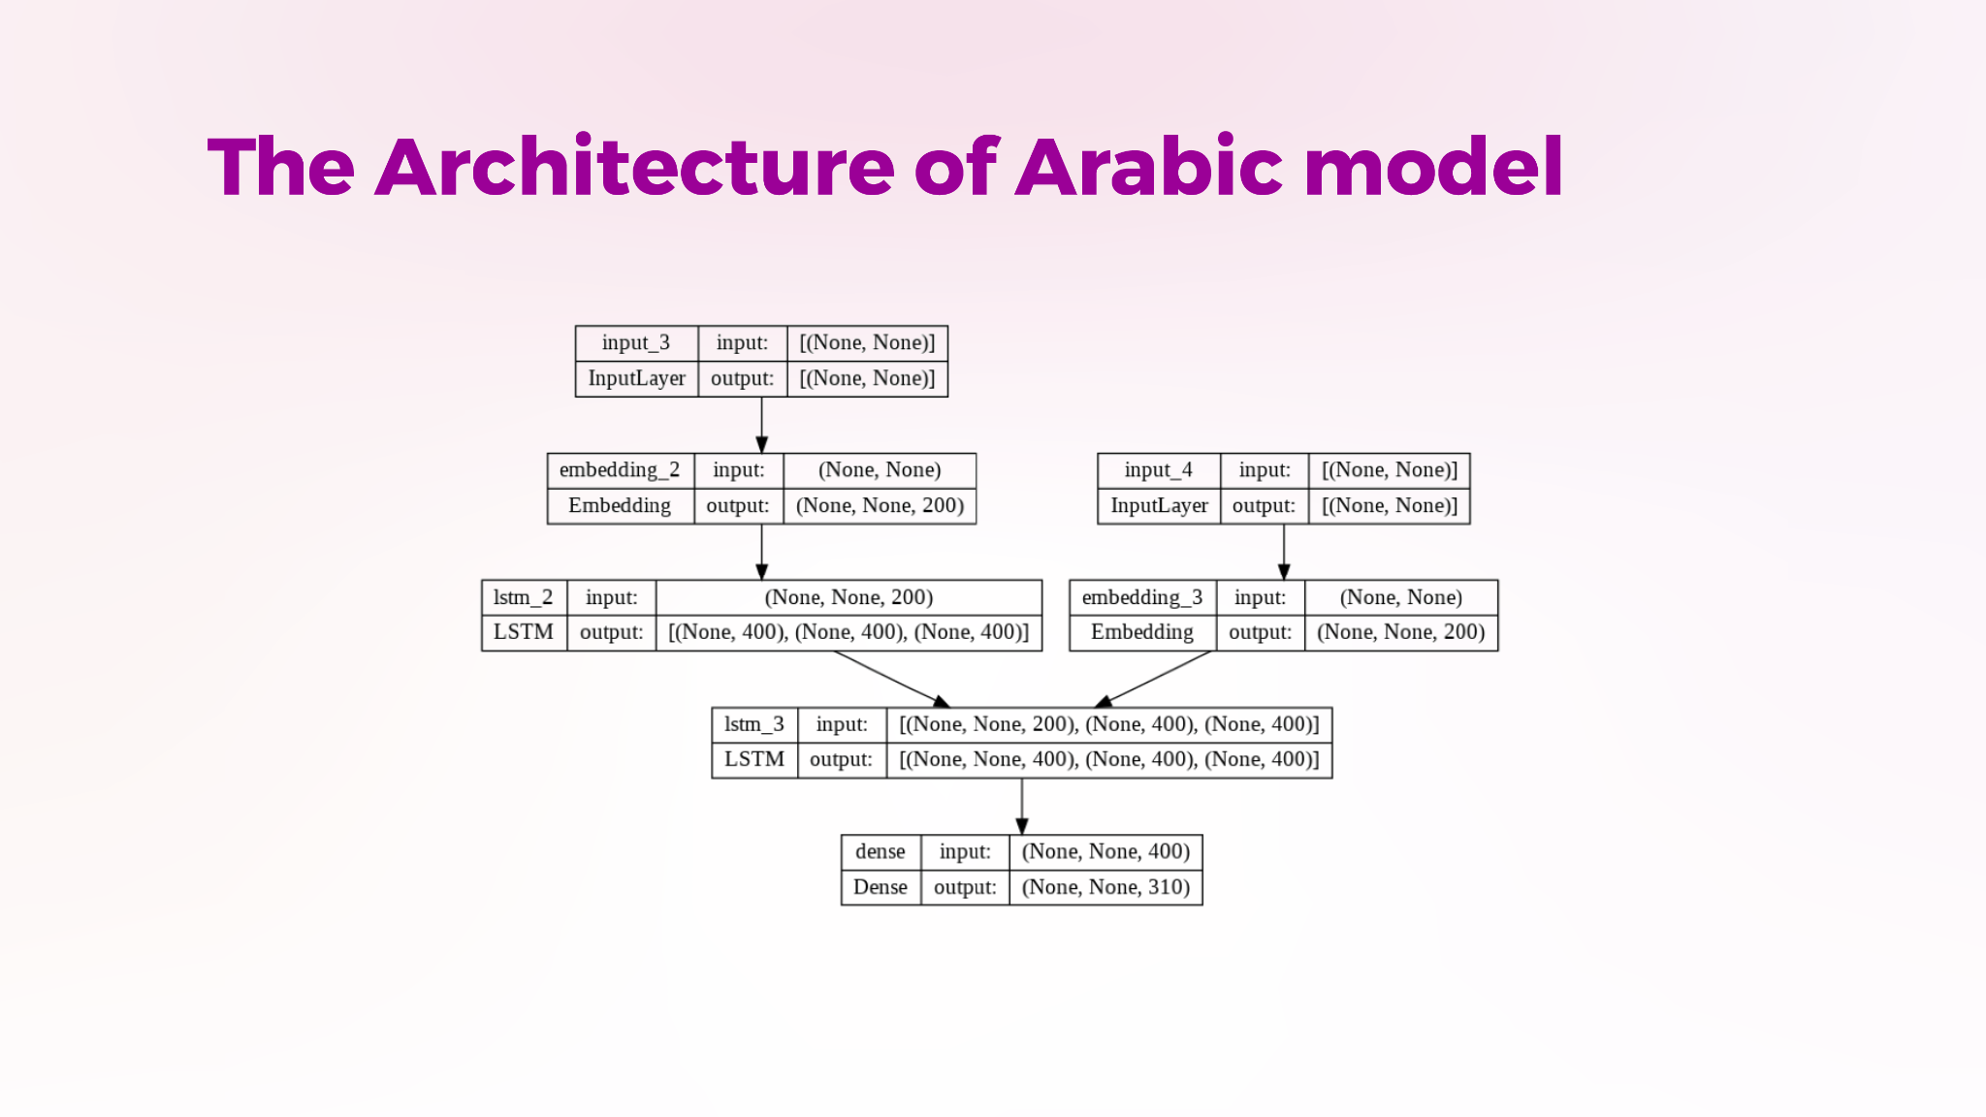

Slide 10
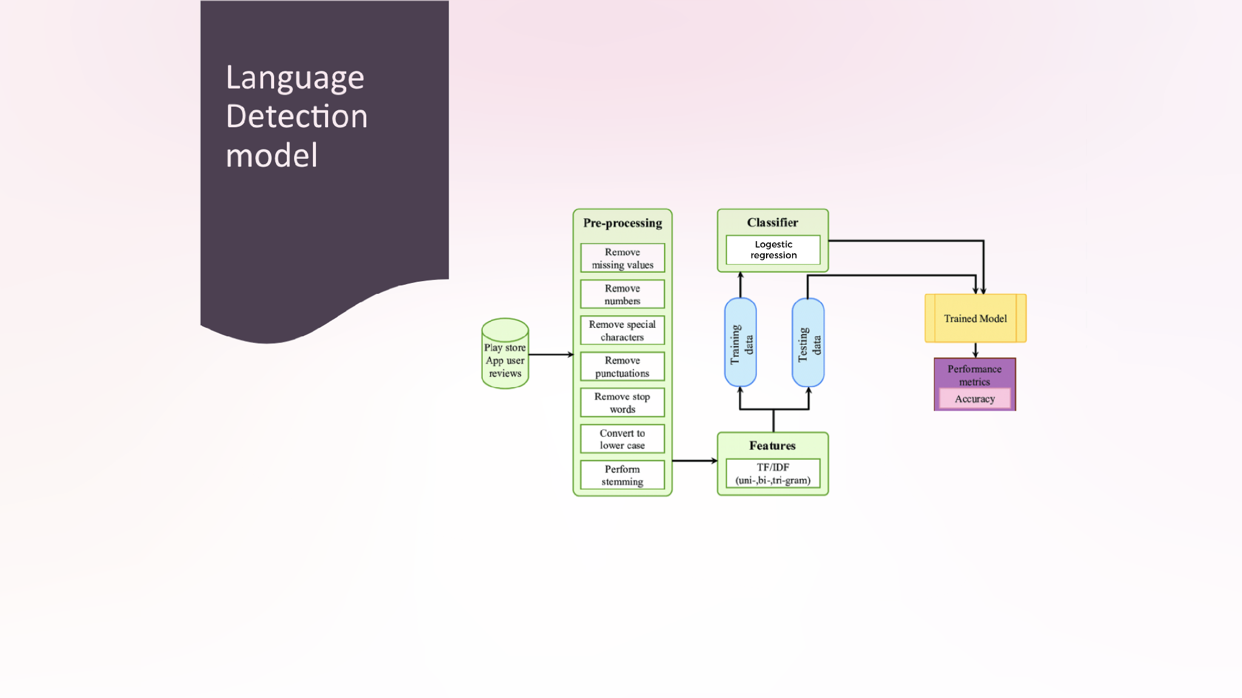

Slide 11
Datasets comparison
Loss

Slide 12
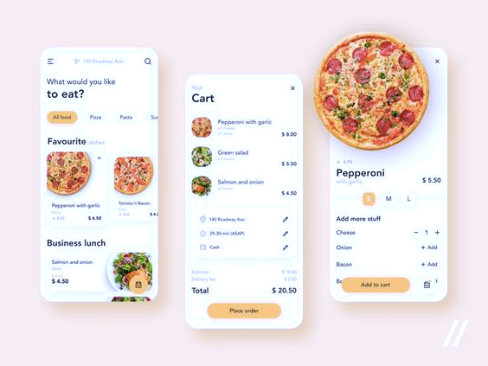
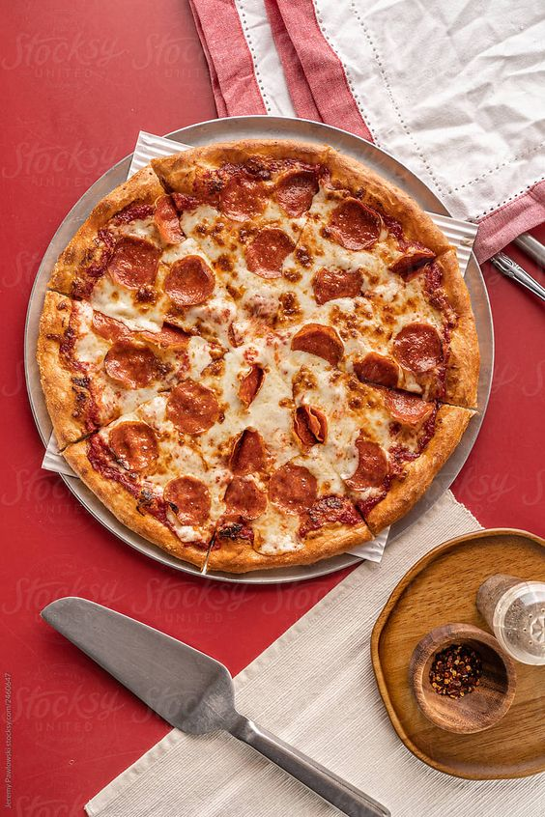
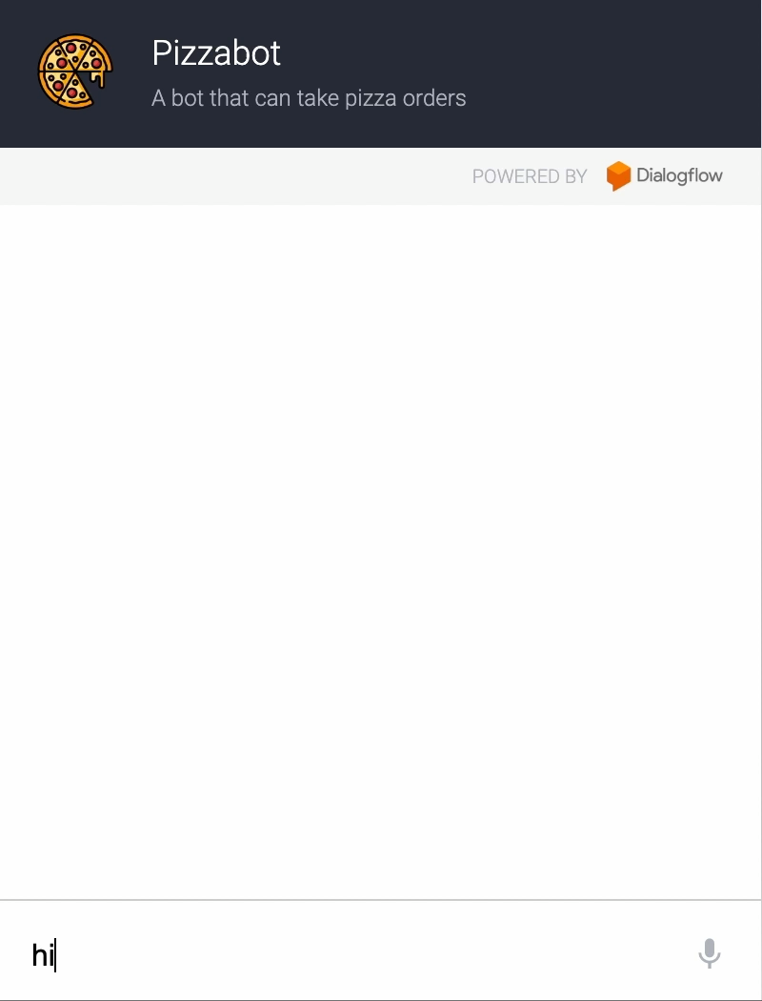



Result
Models | Accuracy
English model | 94%
Arabic model | 99%
Language detection | 100%
Pizzabot

Slide 13
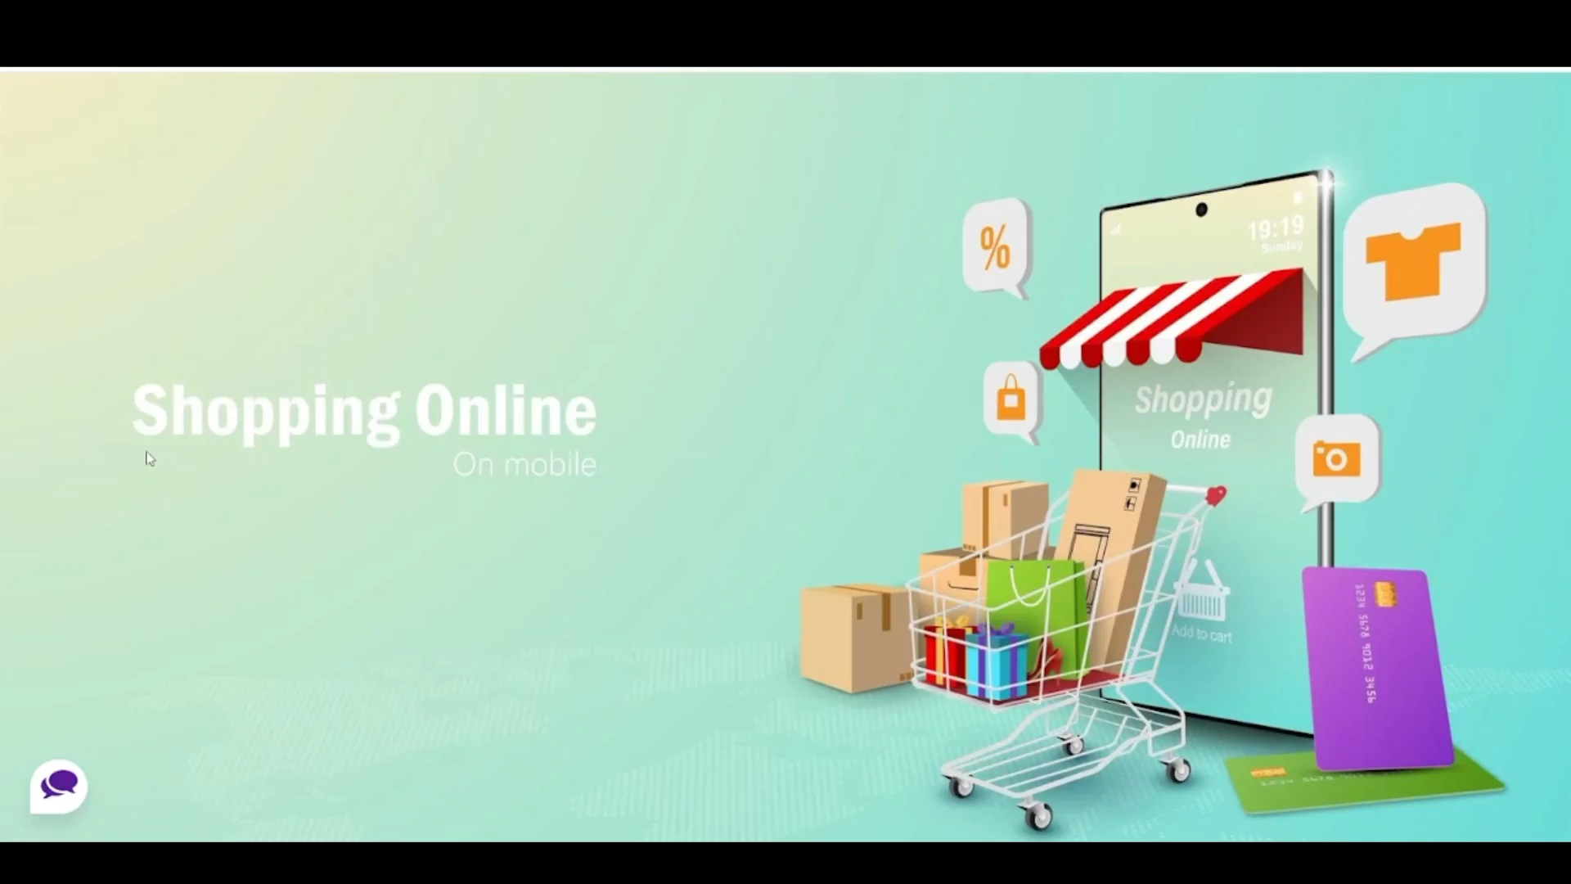

Slide 14
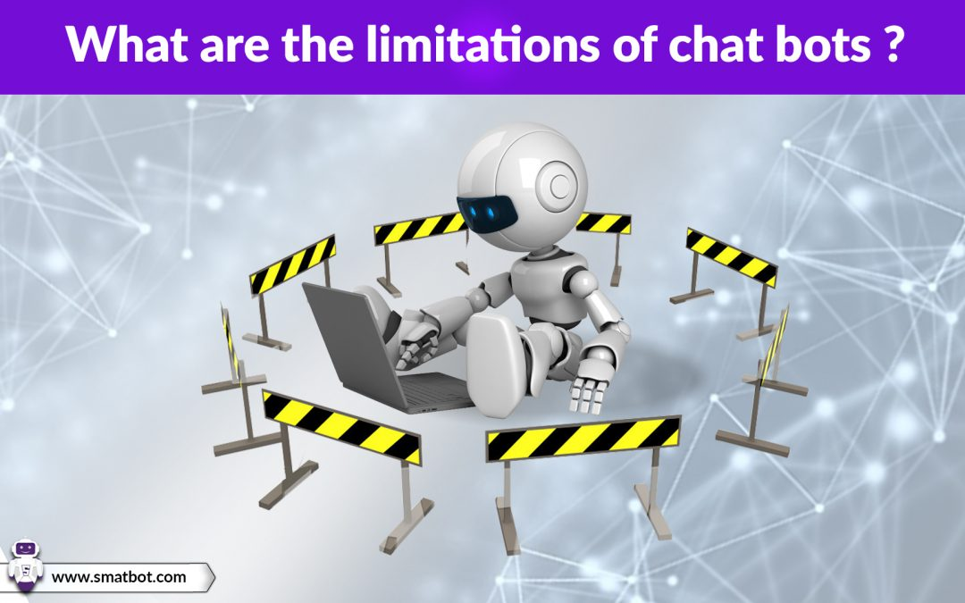
The Limitations of chatbot
Have the Same
Answer
Zero Research
Skills
Have No
Emotions
Can’t Make
Decisions
Don’t understand human context

Slide 15
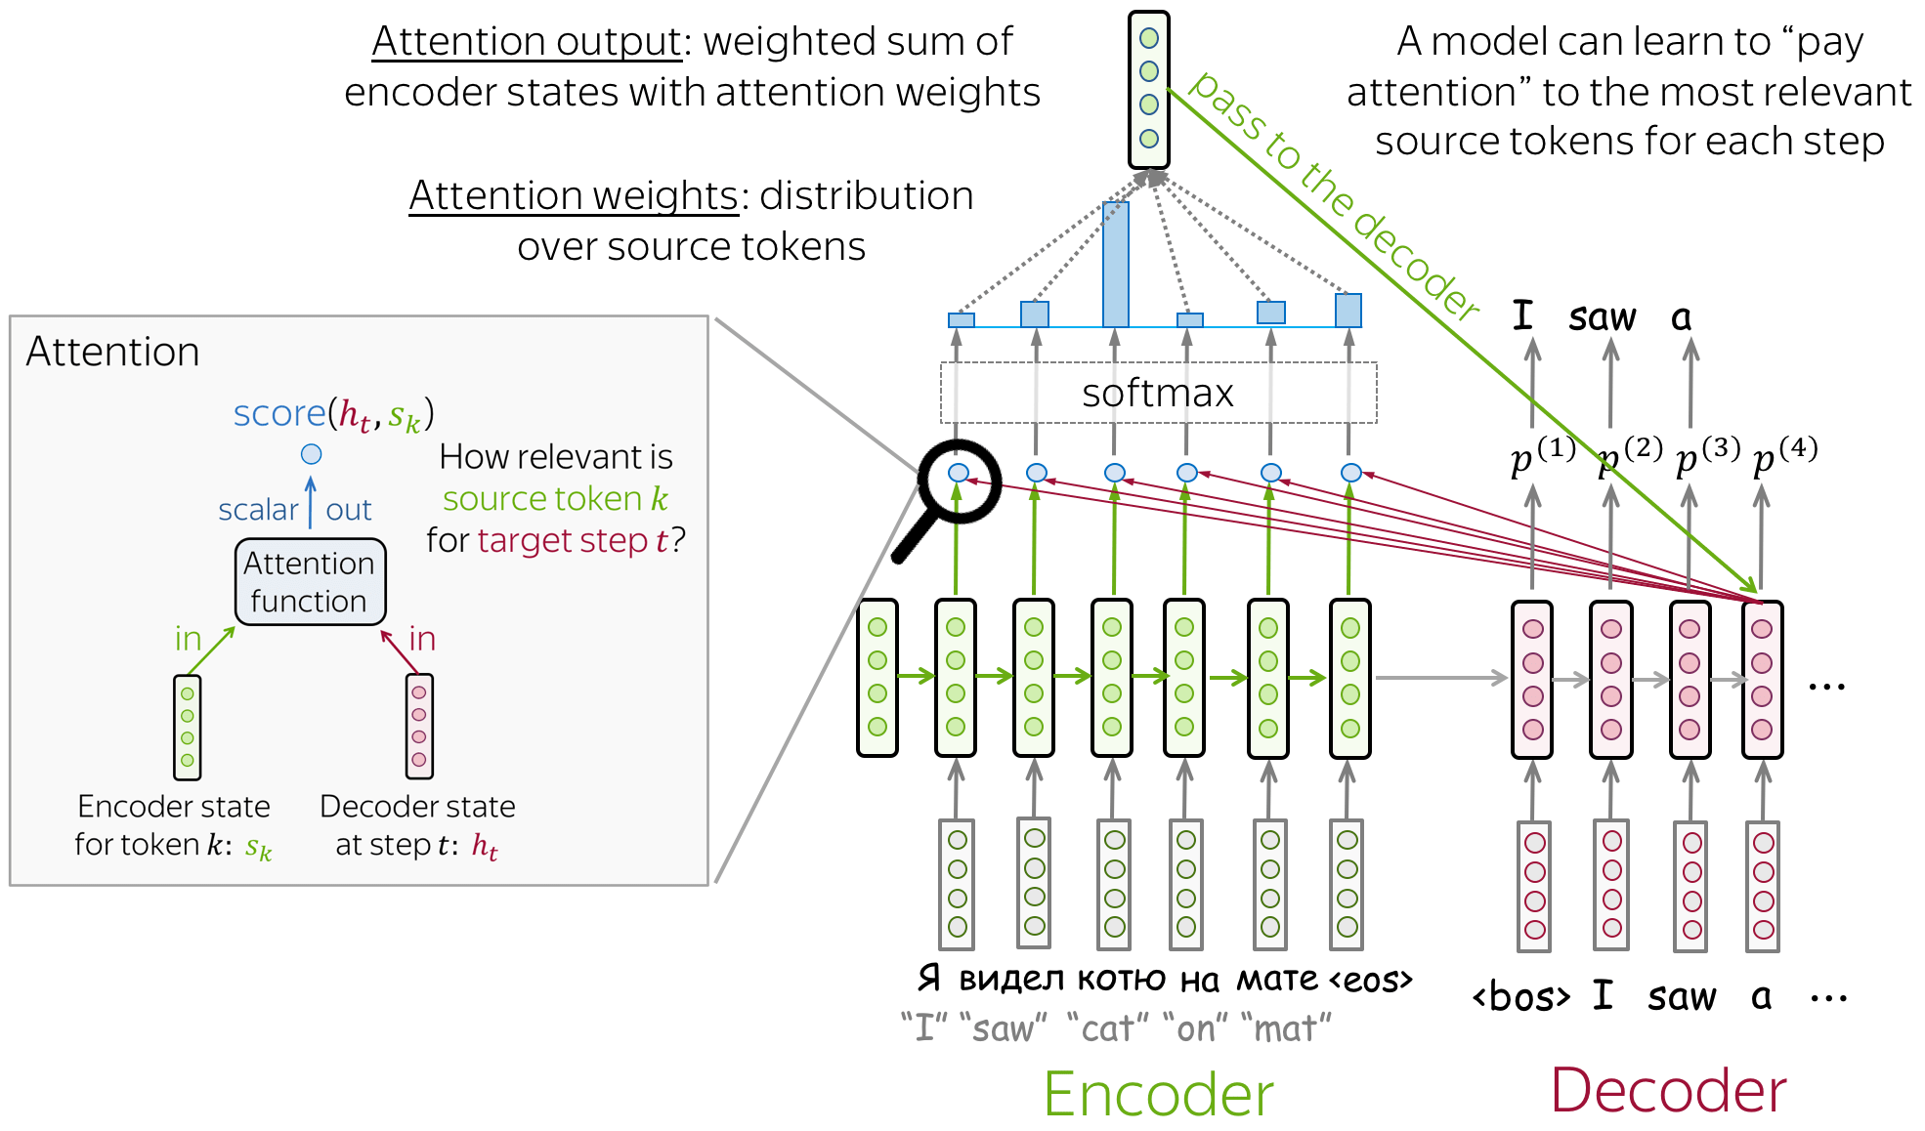
CONCLUSION
Chatbots are made up of a special software where the conversation will be similar to a human interaction. Here, we used Seq2Seq model and Long Short-Term Memory (LSTM) to build our multilingual chatbot.
FUTURE WORK
-Build Seq2seq model with attention

Slide 16


